Slide 1
Savvy Navigation of the Social Media Swamp
KCSHRM Symposium
October 10, 2018

Slide 2
Your Presenter
Jay L. Rosenlieb,
Labor and Employment Chair
jrosenli@kleinlaw.com

Slide 3
Today’s Seminar Will Cover
Pre-Employment
Candidate screening
Leave fraud
Company violations
Public image
HIPAA
Off-duty behavior
Privacy protections
Concerted activity
During employment
Post-Employment
Issues broadcasted
Best
practices
Writing a policy
Policy training

Slide 4
Pre-Employment

Slide 5
Candidate Screening
You use social media sites like Facebook, Twitter, or Instagram to research potential candidates for hire.
Legal risks
Discovering protected classifications
Implicating US Fair Credit Reporting Act
Credit history or driver’s license
Financial history
Other risks
Inaccurate information

Slide 6
Candidate Screening
Fair Credit Reporting Act
Third party providers:
Notice of negative impact and allowing incorrect information.
Take steps for accuracy
Redact information
Obtain
consent

Slide 7
During Employment

Slide 8
Leave Fraud or Protected Leave
An employee calls in sick with the stomach flu
You see them posting pictures to Instagram out on a pub crawl with their friends that same day
An employee files a WC claim for a back injury that puts them out on leave for 2 weeks
Through your fitness tracking program, you see they are exceeding their Fitbit step goal each day of their leave

Slide 9
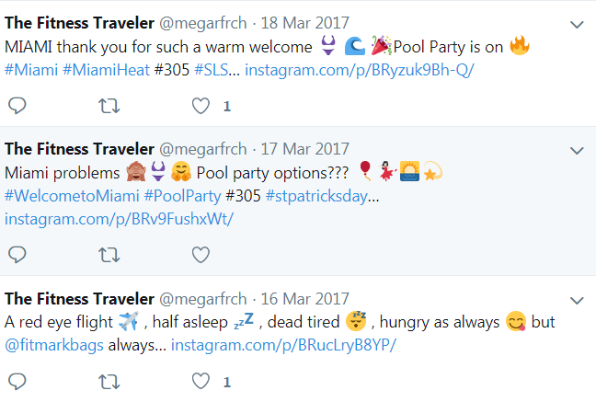
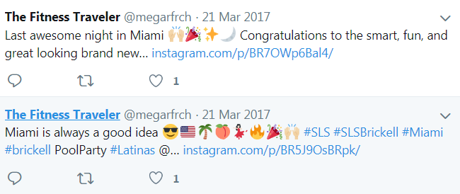
Maybe Not So Sick?

Slide 10
Investigating Violations of Company Policy
Your company upholds a strict non-fraternization policy
You discover through Facebook that one of your managers and their subordinate are on a romantic date.
Your company enforces a zero tolerance drug policy
You come across a post on Twitter, showing two of your employees sharing a joint.

Slide 11
Hits to Company Image
One of your top sales people has a YouTube channel with over 15,000 subscribers
Although they use this channel to promote the company, they also use it for personal purposes and have started a vlog series which openly criticizes local businesses and makes personal attacks on their employees
A group of your employees recently posted a video to Instagram out drinking and making lude comments to women in a bar
They were all in uniform, associating your company with their actions.

Slide 12
Off-Duty Behavior
Potential conflicts of interest
Political behavior
Disgruntled employees
Drinking, profanity, nudity
Whistleblowers
Temps

Slide 13
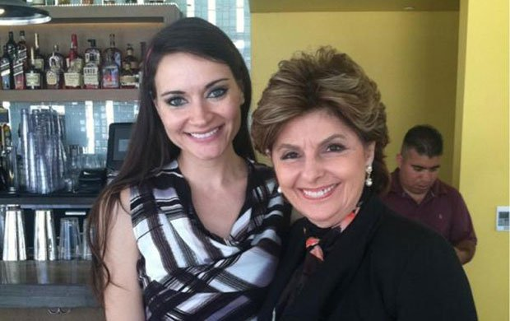
The Case of Caroline
Caroline has been working as a sales representative for over 2 years at Acme. She has an exemplary record at work but is an “at-will” employee.
Recently, you heard from one of your employees that Caroline has been “moonlighting” as a stripper.
Upon further investigation into her Facebook profile you find this to be true. You worry customers will recognize her and that due to the potential of this reflecting negatively on Acme, Caroline should be terminated.

Slide 14
The Case of Caroline
Policies and practices may be non-discriminatory on their face.
Violation of Title VII – “disparate impact” on protected class.
Consistent policies and strict workplace standards.
Requiring individuals to disclose side jobs.
Does it impact ability to perform job?

Slide 15
California Law (Off-Duty Behaviors and Activities)
Labor Code 96(k): Commissioner can assert claims for wage loss for lawful conduct occurring during non-working hours away from premises.
Labor Code 1101: Prohibits discrimination against employee or applicant for exercising political activities.
Moonlighting
off-hours
Non-fraternization policies
Abortion
Extremist political blog

Slide 16
Other Off-Limits Employer Conduct
Conduct associated with protected characteristics
Discussing or disclosing wages or refusing to agree not to disclose wages. Lab. Code 232(a) and (b)
Disclosing working conditions. Lab. Code 232.5
Prevent disclosing information to government or law enforcement when employee believes violation of state or federal status or regulation

Slide 17
Privacy and Social Media
Password Protection/Privacy Laws
Lab. Code, § 980 provides that an employer shall not require or request an employee or applicant for employment to do any of the following
Disclose a username or password for the purpose of accessing personal social media
Access personal social media in the presence of the employer
Divulge any personal social media

Slide 18
The Exception
If there is reasonable belief it is relevant to an investigation of allegations of employee misconduct or employee violation of applicable laws and regulations
Not for:
Anything besides “investigation or related proceeding”
Applicants
Log-in credentials or “shoulder surfing”

Slide 19
Other Privacy Protections
Common Law (e.g. tort of intrusion into seclusion)
Specific Laws
Recording/
eavesdropping
Electronically stored communications
Arrest
records

Slide 20
HIPAA
Protected Health Information “PHI”
Posting of images and videos of patients without written consent
Posting of gossip about patients
Posting of any information that could allow an individual to be identified
Sharing of photographs or images taken inside a healthcare facility in which patients or PHI are visible
Sharing of photos, videos, or text on social media platforms within a private group
Severe penalties for HIPAA violations

Slide 21
Post-Employment

Slide 22
Social Media as a Megaphone
Disgruntled employees/trade secrets
Claims of discrimination
Slander/libel

Slide 23
Best Practices

Slide 24
Writing Your Policy
The most important thing employers can do is write and distribute a policy that clearly states what employees can expect when it comes to the use of media and technology.
Address use of social media
What social media sites are and are not allowed
How and when employees can write about the company, personnel, and products online.

Slide 25
Writing Your Policy
Address use of personal cell phones
Some cell phone use should be banned for safety reasons
You don’t want people texting while driving or operating heavy machinery
General cell phone use (e.g. texting, phone calls) rarely becomes a serious issue in the workplace, so address any problems that come up on a case-by-case basis.
Address use of personal email
If you want to restrict employees’ access to their personal email accounts, spell that out clearly in your policy.

Slide 26
Putting Your Policy Into Practice
Writing your policy is the first step, but be sure it isn’t the only one.
Host regular trainings which demonstrate the policy
This helps your employees understand:
Why the policy is in place
It’s everyday application
The repercussions for violation

Slide 27
We value your feedback

Slide 28
Your Presenter
Jay L. Rosenlieb,
Labor and Employment Chair
jrosenli@kleinlaw.com

Slide 29
Savvy Navigation of the Social Media Swamp
KCSHRM Symposium
October 10, 2018

