Slide 1
10 Business lessons learned using escape games
Dana Martin
Workplace Escapes
Schoolhouse Escapes

Slide 2
Teamwork humor:

Slide 3
The industry
What is an Escape Game?
What is Gamification?
Escape games are a type of live action, team-based physical adventure game in which people are locked in an immersive room with other participants and must collaborate to solve a series of puzzles, find clues, and escape the room within a set time limit.
Gamification is a word that has become synonymous with rewards. “Reward-based gamification”
Meaningful gamification is the use of gameful and playful layers to help a user find personal connections that motivate engagement with a specific context for long-term change.

Slide 5
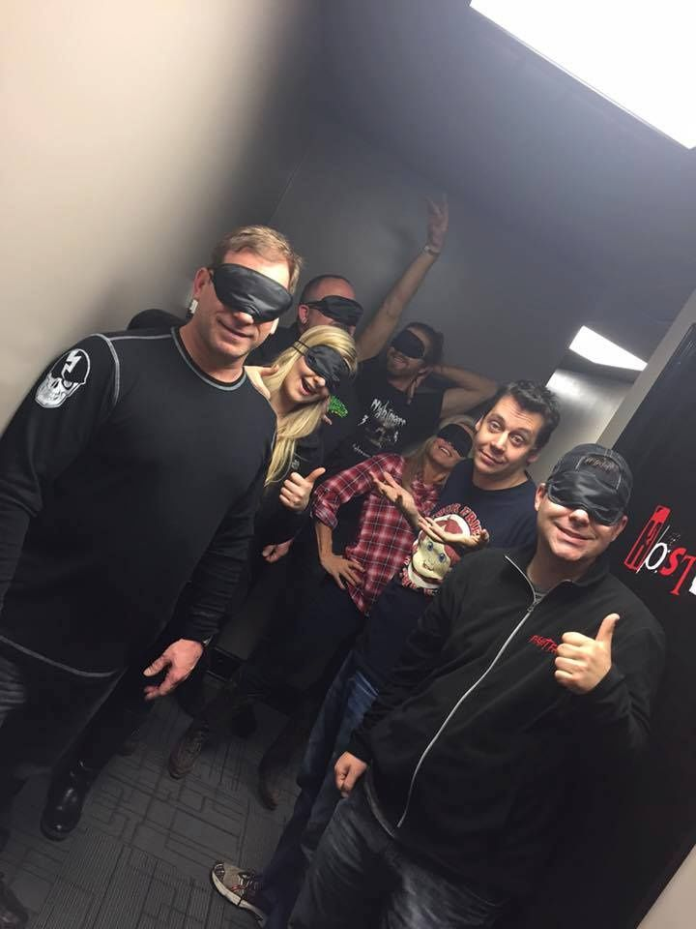
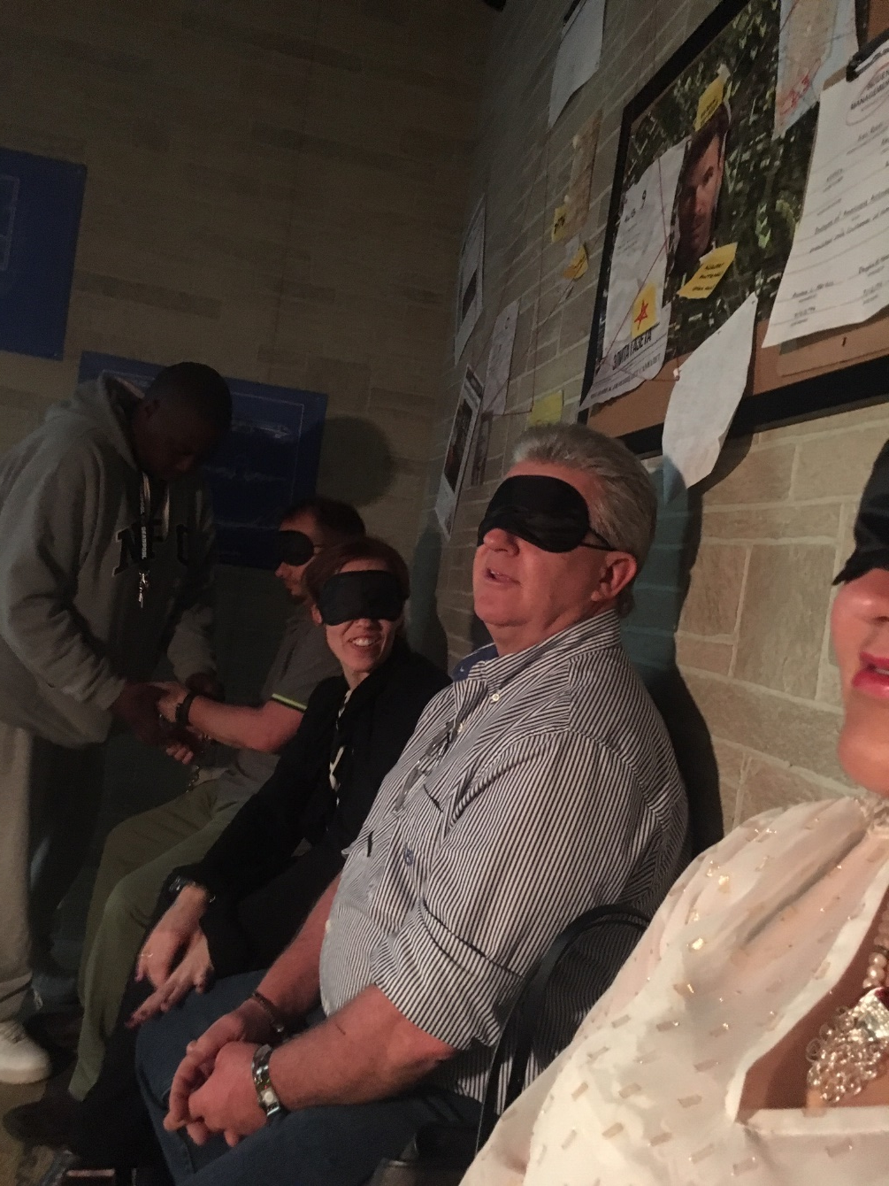

Slide 6
Types of escape games
Escape a Specific Unpleasant Place (Dungeon, Prison, Preschool, etc.) 30%
There is no overarching narrative other than "Escape the Room" 16%
Investigate a Crime or Mystery 9%
Engage with the supernatural 8%
Solve the Murder 5%
Defuse the explosive device 5%
Be an Adventurer 4%
Gather Intelligence or Espionage 4%
Carry out a Heist 4%
Find the Missing Person 3%
Help Create Something (such as a cure, a potion, etc.) 2%
Military Operations 2%
Free another person or animal 2%
Survive! 1%

Slide 7
How can companies use escape games?
Recruitment Assessment
Team Building and Motivation
Integration of New Hires
Leadership Development
Training and Assessment

Slide 8
How can companies use escape games?
Recruitment Assessment
If you’re hiring an entry-level person, you can get a feel for how they take direction and criticism.
Candidates must prove they are willing to succeed collectively, not just individually.
Look at escape rooms as a physical manifestation of a business objective: at the office, we all have different responsibilities but are working together to achieve goals we’ve set. In the escape room, people use their skills differently but work together to find a way out of the room. You can learn more about a candidate in a one-hour escape room session than in the dozens of hours spent during the hiring process.

Slide 9
How can companies use escape games?
Team building and motivation
Escape games emphasize working together, communicating effectively, delegating tasks, and thinking creatively, which are strategies employees can use at work in the real world.
Escape games engage a number of different personality and skill types so participants can look for ways to contribute will play to their strengths.
When everyone contributes, there are more opportunities for shared learning and bonding.

Slide 10
How can companies use escape games?
Integration of new hires
With this assessment, the focus isn't only put on the individual, but also on the collaboration of the individuals within a group or team. How do they work, communicate, cooperate with each other? Where are the potential areas of conflict?
Coachability, emotional intelligence, motivation and temperament are much more predictive of a new hire’s success or failure. Do technical skills really matter if the employee isn’t open to improving, alienates new coworkers, lacks emotional intelligence and has the wrong personality for the job?
Observe how candidates interact with other team members, whether or not they are able to listen and communicate, and how valuable their ideas and propositions were when formulated under stressful conditions. Candidates must prove they are willing to succeed collectively, not just individually.
Notes:
According to a study by Leadership IQ, a global leadership training and research company, 46% of newly-hired employees will fail within 18 months. But contrary to popular belief, technical skills are not the primary reason why new hires fail; instead, poor interpersonal skills dominate the list, flaws which many of their managers admit were overlooked during the job interview process.

Slide 11
How can companies use escape games?
Leadership development
These games are designed in such a way that one person alone cannot solve everything on time. They place an emphasis on teamwork, motivating each participant to use their unique skills and abilities to contribute.
This is a unique opportunity to see who in your organization may have hidden leadership capabilities.
The smartest person in the office isn’t always the one who saves the day.

Slide 12
How can companies use escape games?
Training and Assessment
“Plotter vs Pantser”
Who is creative?
Who is the detail person?
Who is organized?
Who is the realist?
Who is the “judger?”
Who gives up?

Slide 13
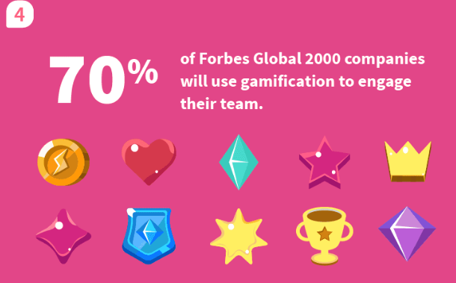
Officevibe.com “10 Shocking Statistics About Disengaged Employees”

Slide 14
Which of my employees can actually think critically?
The games are structured in a unique and engaging environment that causes the players to think resourcefully and quickly. By using their competitive nature, players are compelled to use their thinking skills to solve the mystery of the game room. Thinking is one of the most important cognitive skills to use in this activity. The players will literally grasp how to use thinking as the way to escape from the game room.
How well do they communicate with one another?
There are those who use cutting language and those who know how to bounce on an idea emitted by a colleague. Faced with stress and the necessity to collaborate with others, employees will reveal their authentic communication methods. With so much going on in the room, participants must make sure their idea or discovery is heard by the group. Communication skills for all are heightened in this scenario with the added time pressure!

Slide 15
Who has the best problem-solving skills?
Can they think on their feet or do they need some guidance? Everyone on the team is equal and could very easily hold the creative genius inside of them that is required to find the key. Traditional training programs may not reveal a hidden problem solver on your staff.
Do my employees use their time wisely?
In an escape room, I can see if the team member gets flustered or takes a calm, collected approach to solving the puzzles presented.
How much time do they spend on meaningless tasks?
The time constraint under some sort of threat can be a meaningful way to observe time management skills.

Slide 16
Is my staff productive under pressure?
Who follows directions; who is taking the lead? Who has the brightest ideas? Who combines the outcome and leads it to the final result? Who is going into the nitty-gritty details? Who is leaning back watching the effort of the group? Who is at the group's service? Who is working closely together with one or more colleagues? Who is arguing with whom? Who has the biggest ego?
Are my leaders leading, or am I missing a potential leader?
Nationwide, teams do not escape primarily due to lack of leadership. They simply do not have enough leaders in their group to suggest concepts and decide on a path to follow. It will take more than one strong leader to put everything together as there are multiple tasks that need to be completed simultaneously. This is a unique opportunity to see who in your organization may have hidden leadership capabilities.
If you’re hiring a manager, you can see if they take charge and provide structure to the madness.

Slide 17
Do the selected team members work well together?
Escape rooms are an incredible way to learn if you have team players. Do they try to do the entire process themselves? Do they just sit back and let other people do the work? Or do they use their skills to contribute to the victory, working as a team to boost morale, achieve a sense of “togetherness,” and grow in ways beyond imagination?
Can team members think of their feet or need guidance?
Who is a team player, who is organized, who keeps a clear head? Is your team going to panic or press forward and continue trying to figure out clues? If there is chaos in the room it will be difficult to accomplish the mission, so an employee that panics and doesn’t keep a clear head could slow the team down.

Slide 18
What are my team members’ strengths? Weaknesses?
Who follows directions; Who is taking the lead; Who has the brightest ideas; Who combines the outcome and leads it to the final result; Who is going into the nitty-gritty details; Who is leaning back watching the effort of the group; Who is at the group's service; Who is working closely together with one or more colleagues; Who is arguing with whom; Who has the biggest ego?
Were my team members open to learning about their colleagues?
The real proof of the success of corporate training is in observable behavior assessment and change. Escape games present a process to measure actual change in opinions, thought processes, and pre-conceived biases.

Slide 19
How much does your company actually invest in employee engagement and retention?
Zero? According to data from Chronus, 79% of HR professionals worldwide feel they have a major engagement and retention problem.
You might want to try a new approach. According to officevibe.com:
70% of U.S. workers are not engaged.
Companies with engaged employees make 2.5x the revenue.
Highly engaged employees are 87% less likely to leave their company.

Slide 20
Dana Martin

